Slide 1
SGO Area: Digital Commercial– Field Force Engagement
Solution Name: Mendel
Presenter : Raju Chowdhury

Slide 2
Mission Statement
The Mendel tool helps Brand Directors and Area Sales Managers who want to have better understanding of their customers (Physicians/Specialist/ Healthcare center) by analyzing factors that are driving their drug prescribing behavior and evaluating impact of diverse promotional activities. It will be a web based AI/ML solution that guides sales representatives with 360⁰ insights about each customer and provides recommendations on Next Best Action/Plan/Offer for their next call to augment brand image and boost sales.

Slide 3
Agenda
Market Overview
Solution Outline and USP
Business Perspectives

Slide 4

Market Potential
Top10 pharma spends in Sales & Marketing
Spend on F2F promotional activities (Rep’s Call)
>$100B
55%
Global marketing efforts targeted towards physicians ($92B approx.)
Sales representative in US alone
68%
>70K
Notes:
https://www.latimes.com/science/sciencenow/la-sci-sn-medical-marketing-money-20190109-story.html

Slide 5





Reps/Organization challenges today
Restricted Access
Regulatory Constraints
Price / Margin Pressure
Departmental Silos
Notes:
But first we must realize what the main pain point of Sales reps and what we need to address through our solution

Slide 6
Our focus for Sales Force Effectiveness
Conventional Touch Points
Walk-in
Call
Direct Mail
Sample
Speaker Program
Other..
Digital Touch Points
Engagement Portals
Webcasts/Webinars
E-Detailing Systems
E-mail Marketing
Mobile Apps
Others..
Success Factors
Standardize Promotional Plan
Relevant Analytics
Continuous Support Model
Uniform view of markets
Real Time Insights
Go to Market Strategy

Slide 7










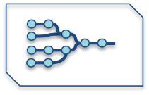

Solution process overview
1
2
3
Clients from different geographies send customization request to Cognizant
Cognizant does the necessary customization in solution and shares back the version.
Setting Context: ASM and Brand Managers to identify profiling parameters within their region
4
6
Distribution among Reps: The application link is shared with field reps with latest market configuration
Tracking performance: Portfolio Owners can assess the performance and take strategic decisions.
5
Continuous Evolving Model
HCP 360 ⁰: Consumer behavior and trends using open source data
Account Profiling: Rep enters HCP interaction information .
Utilization of other Data sources: Use of available data sources (primary & secondary) for additional analysis
Segmentation : Accounts are segmented using AI/ML Clustering
NBA/NBP: Suggestion for Reps to set their strategy and goal .
Evolving Models: Inputs stored across users to study key driving factors and evolve Propensity model
7
© 2018 Cognizant

Slide 8
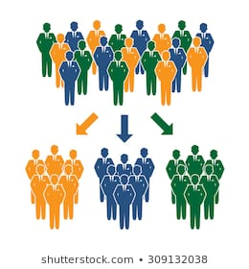
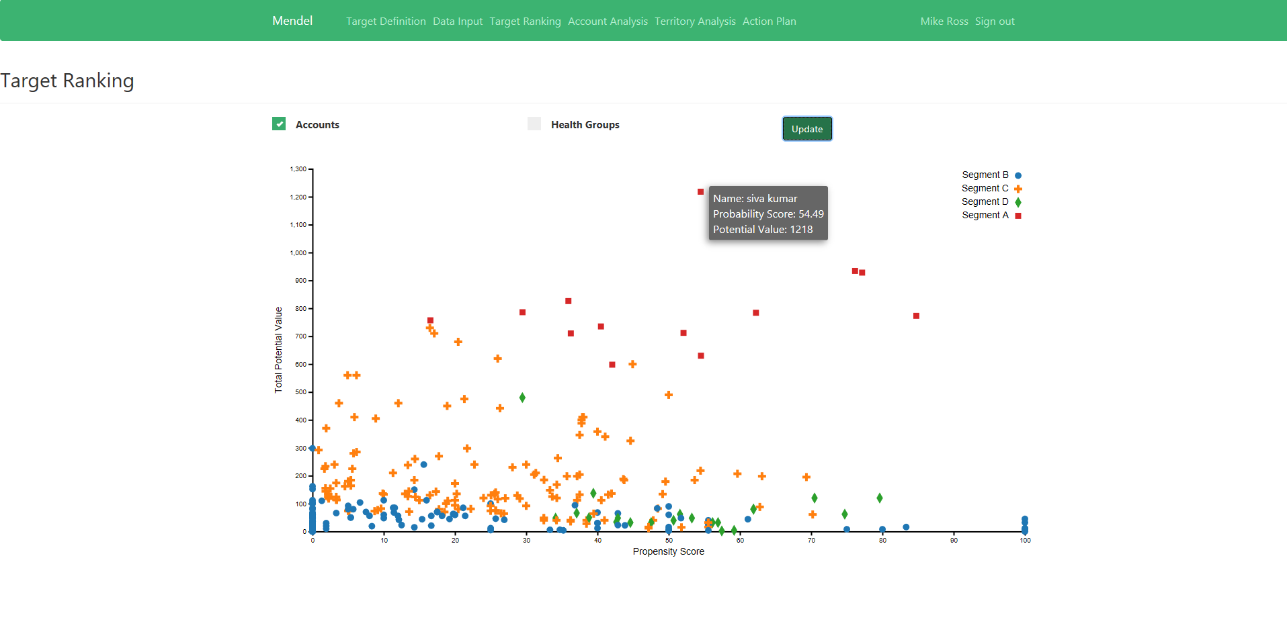






Identify potential customer segments using AI/ML
Mendel Prototype Snapshot
Market Potential
Rep
Notes
Multi-dimensional segmentation approach
Recognize key factors influencing prescribing pattern
Equipped to effectively address brand unique needs
Real time updates

Slide 9


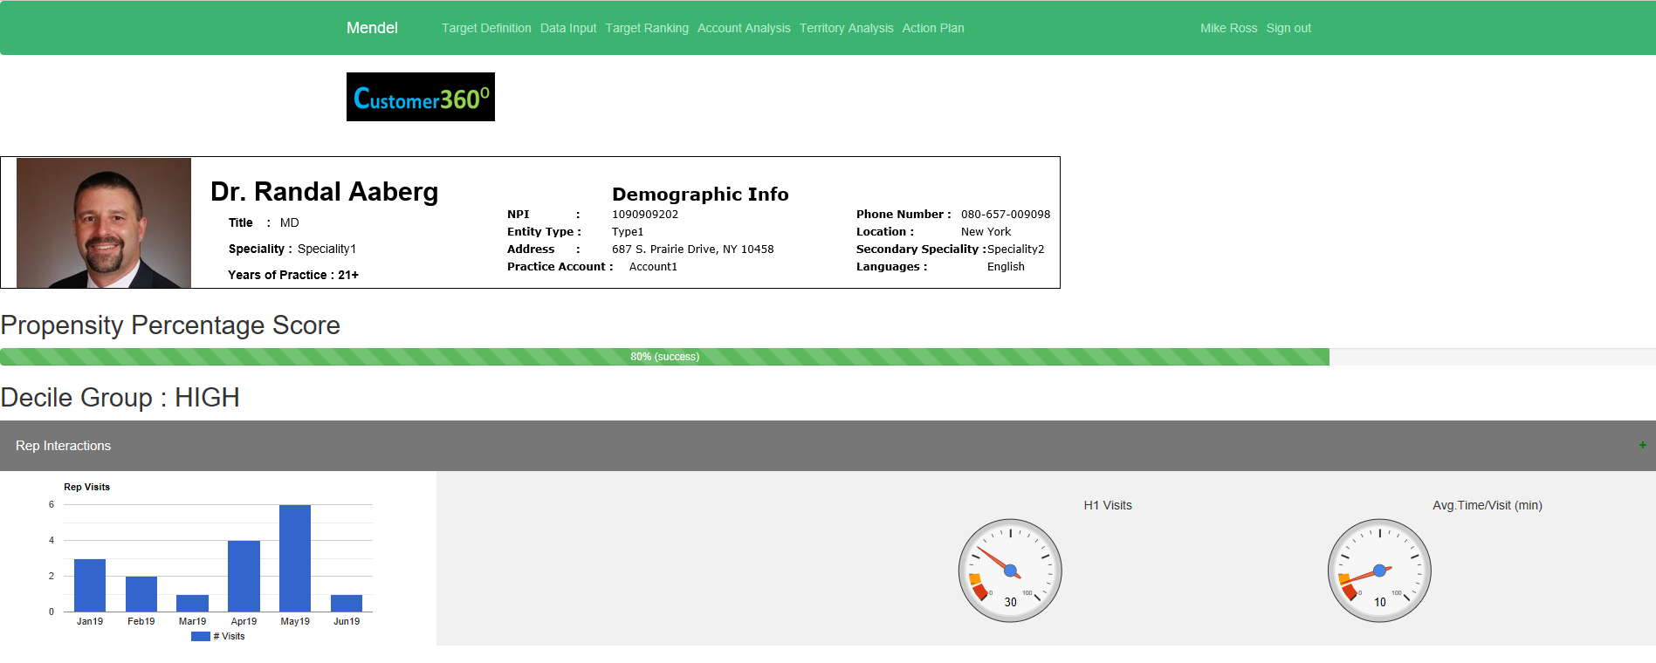
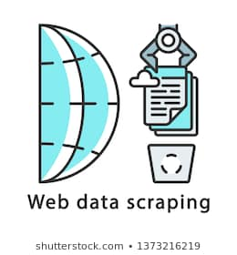
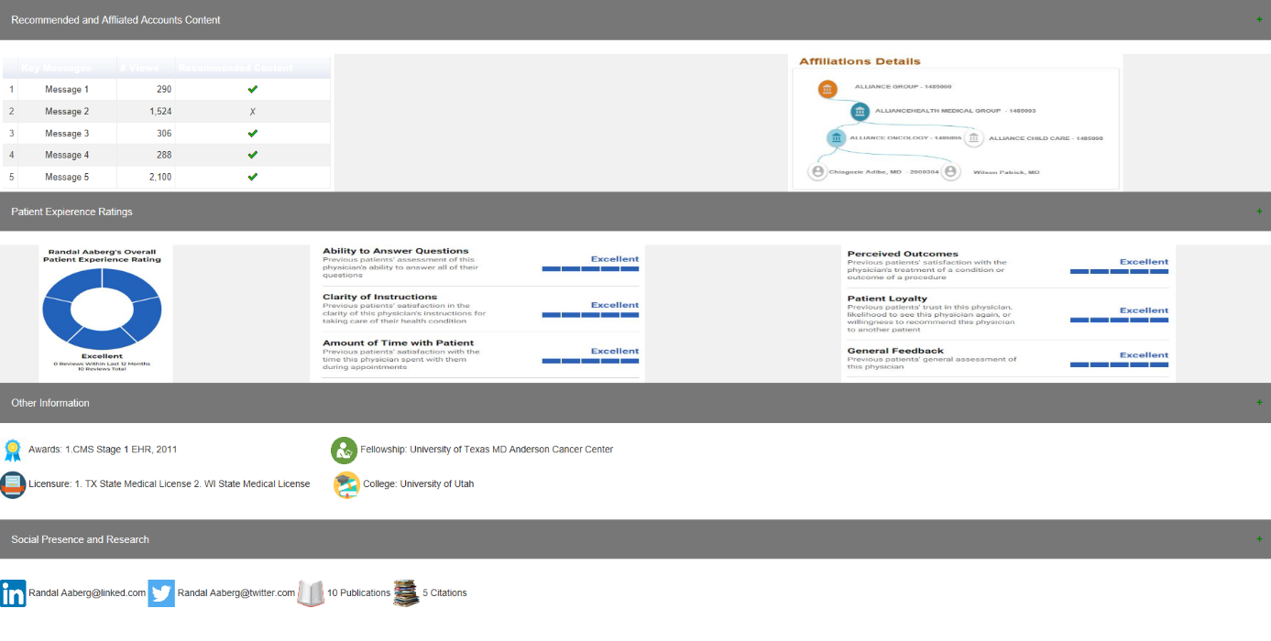


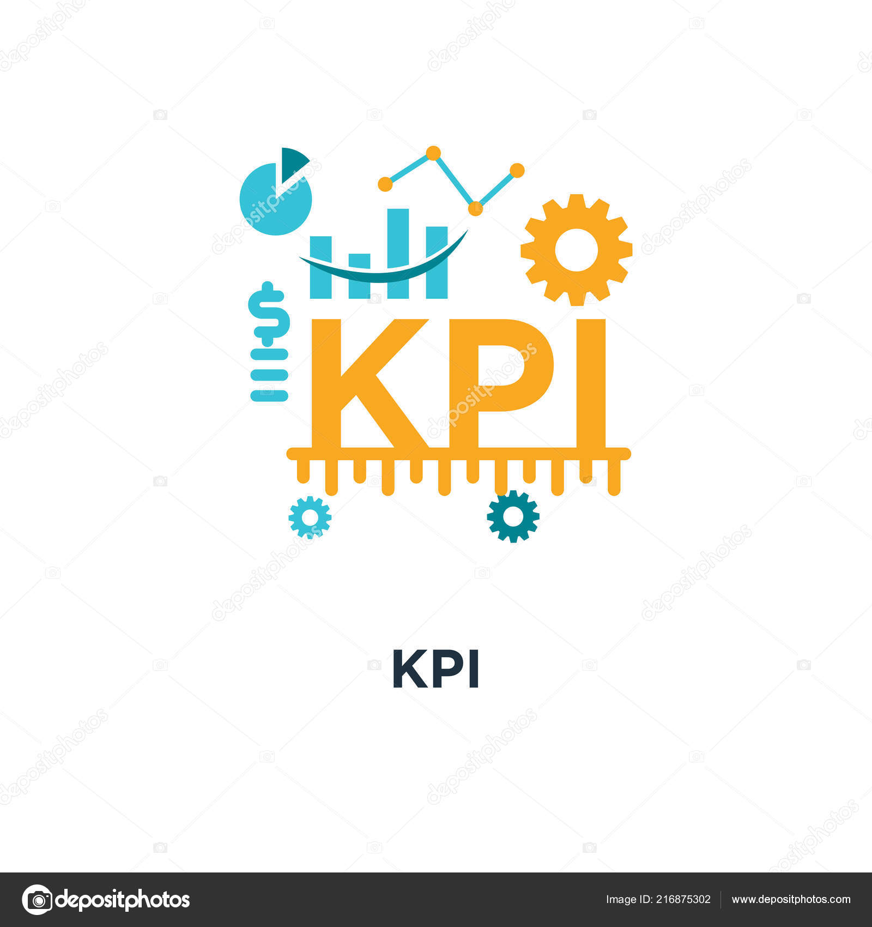
Customer 360⁰
Mendel Prototype Snapshot
Client System
OPEN SOURCE
Calls, Emails, Digital Touchpoints, SFE data from tool
Cafe Pharma, Viva Open data, NPI Federal Site, Health News, CMS Payment, etc.
Customer 360 Data Store
NLP with Deep Learning
Sentimental analysis
QUANT Modelling
Clustering Propensity Score
Descriptive Analytics
Decile
Demographic details
Affiliations
Payment data
Engagement Channel
Behavioral Info

Slide 10
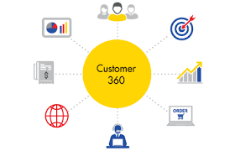
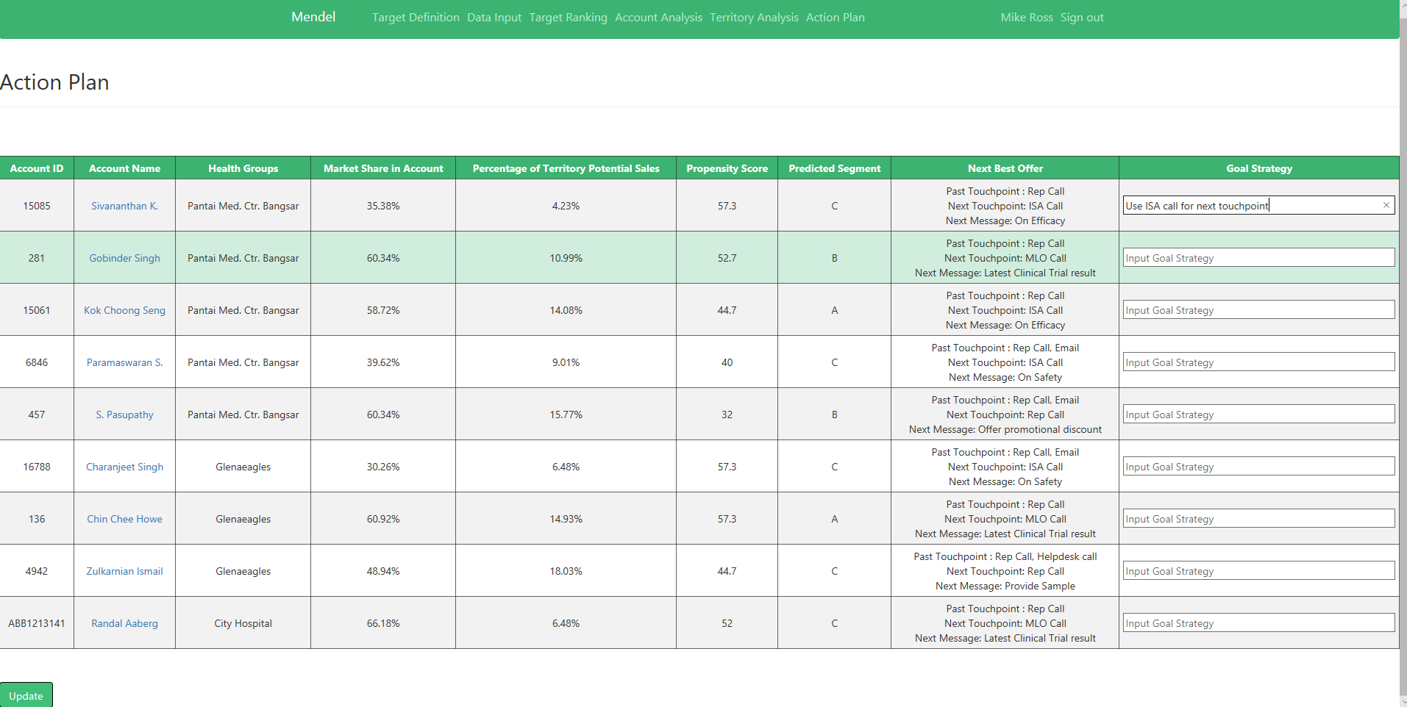
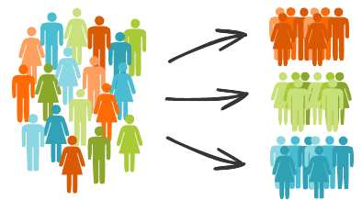
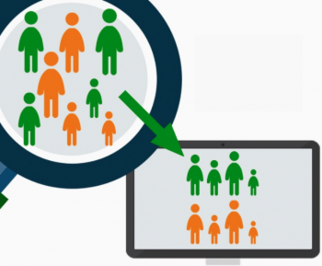

Recommendation Engine
Customer 360 Data Store
Client System
Mendel Prototype Snapshot
Affiliation, Alignment, Call Activity, Call Plan
Cluster Analysis
Classification
Model
Segment
Recommendation Engine
Hybrid Approach (ML + Rule Based)
Propensity Score
Recommended target list of HCP/ Accounts
Suggestions for next best plan/actions/offer

Slide 11




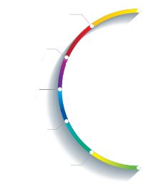








Converting information to tactical action..
Dr. John channels of communication
Rep’s recommended action for Dr. John
Mendel
Tweets.. Are there any side effects to Patients
after using Brand A
Safety Messages Emailed
Posts.. Attending a
Speaker Program
in Seattle
Web Scrapping
Behavioral Analysis
Scheduled a
KOL Meeting
Searches!
Medication Guide
in Brand Website
of company
NLP
Real Time
Medication Guide is Emailed
Publication and
Research Information
Seek Approval to fund
for Johns research
Feedback Ratings
Deep Learning
Affiliated Accounts
Information
Right Account Identification for Better Targeting

Slide 12



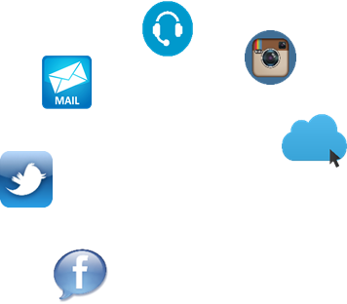
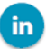


And develop customized physician journey
JOHN, 56 years
22 Years of Exp
Initiated the Shipment of Sample Delivery
Structured
Focused on Research
Unstructured
Prefers Rep Visits
Opts for Sample delivery
Multiple Affiliation
Books appointment for Walk In
Seek Approval to Fund Research
Right Account Identification for Better Targeting
Customer delight
Research funding, On time Sample Delivery
Right offerings helped to Brand Conversion
Brand Loyal
NLP
Sentimental Analysis
Custom Offers
Next Best Plan /Offer
Customized Offers for Customers
Higher
ROI
Data Sources
Client System & Open Source
Mendel Al
Deep Learning
Mendel
Behavioral Modelling
ML based Suggestion Engine
Likes to Experiment
Right Channel Identification helped to Brand Conversion
Unstructured
Structured
Brand loyalty
Customer Centric Approach
Active on Physician Community and Social Media
Visits Brand website for Drug Safety information
Prefers ISA calls
Kraig, 37 years
6 Years of Exp
Sales Rep ISA calls with Recommended Content
Safety Messages Emailed

Slide 13
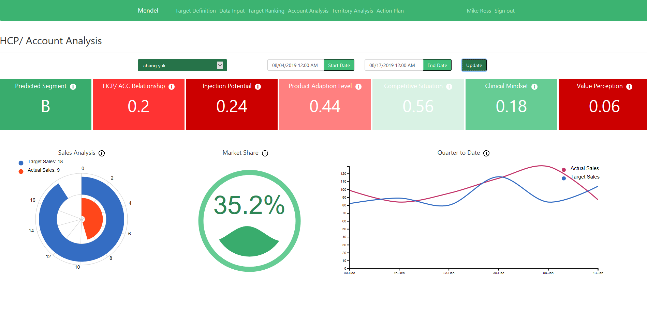
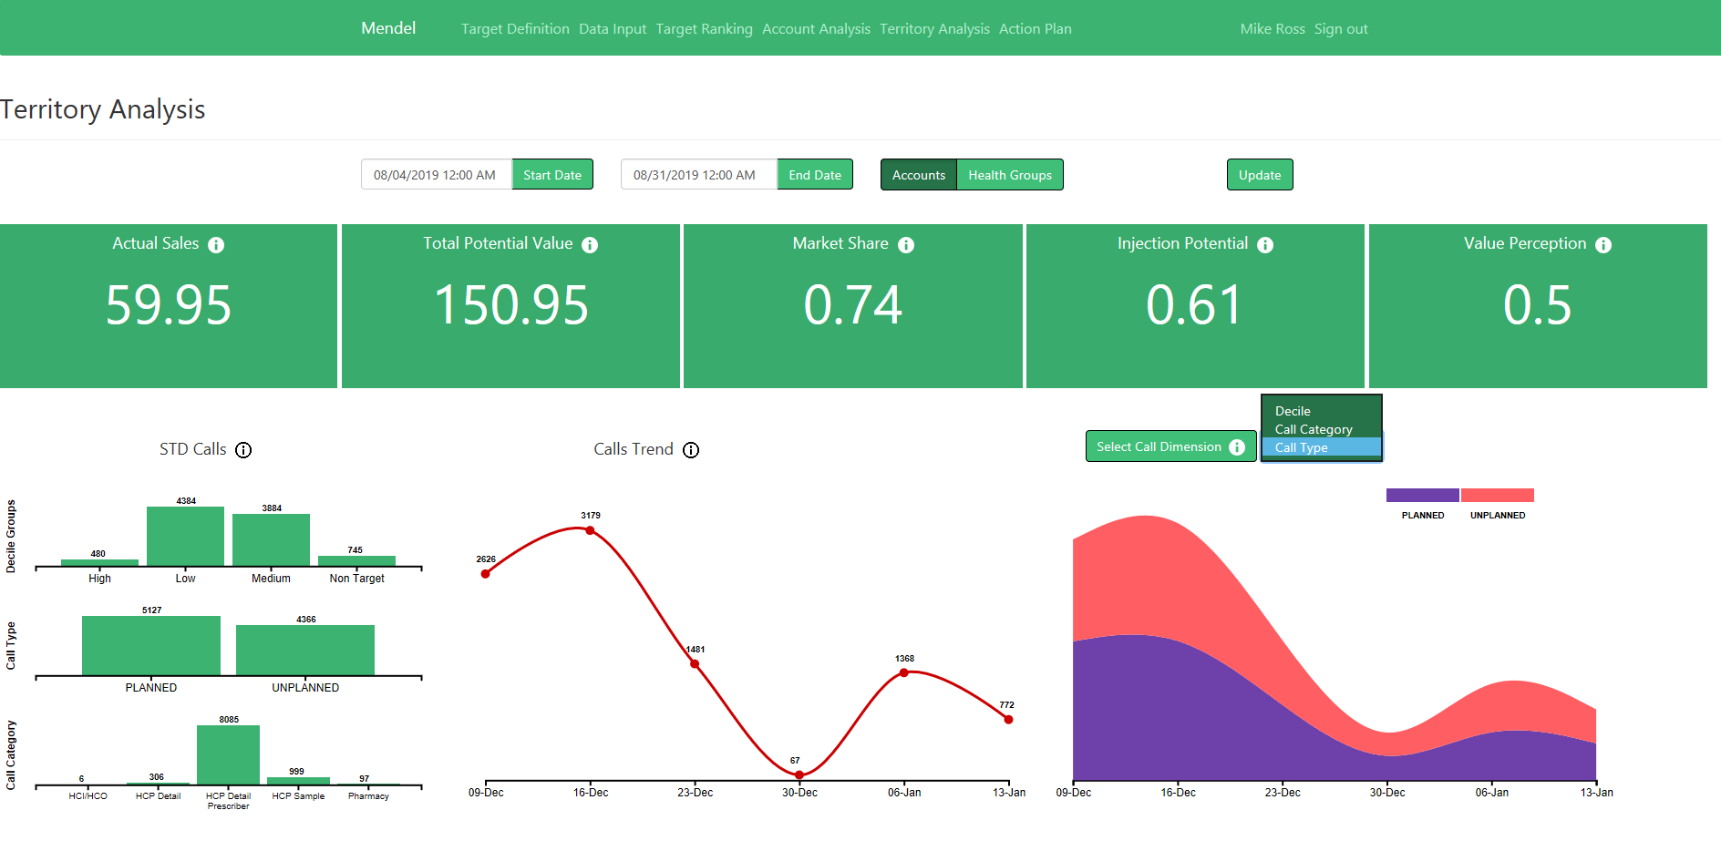
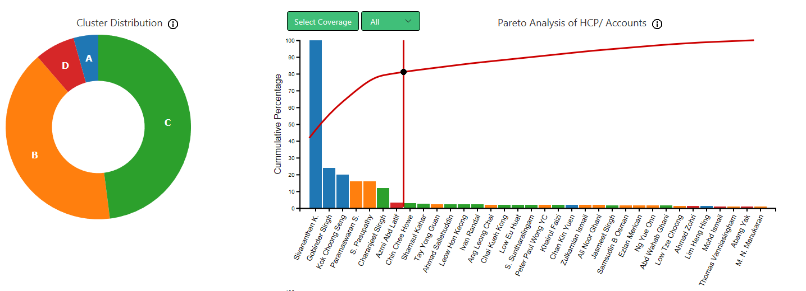
Performance Analysis
Mendel Prototype Snapshot
KPI’s to evaluate physician / territory performance and design strategic plans

Slide 14


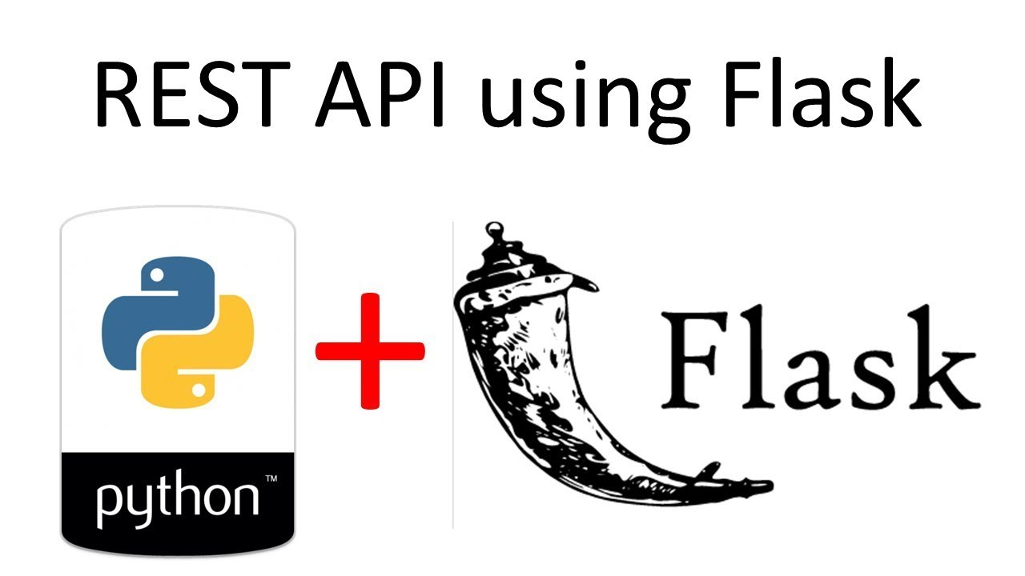




Technology Landscape
Integrate with Client Infrastructure
All Open Source Technologies
Zero Investment from Cognizant on Licensing cost
Notes:
We intent to submit IP for the tool

Slide 15
Revenue Generating Model
Licensing Cost
Illustrative Revenue Model
1
The intent is to get an IP for solution and will be deployed at Client’s environment based on annual licensing cost
Particulars | Cost $
Mendel | $ 300,000
Deployment Cost | $ 0
SME | $ 42,000
Total | $ 342,000
Deployment Cost
2
Solution to have flexibility to opt for individual modules
For limited modules, there will be deployment cost
Cost to be waived of on selection of most / all modules
Assumption
Implementation for one Product/Franchise
Licensing Cost for 1yr, subsequent year cost to reduce for same features
Data sources to be finalized at onset. For addition /deletion later to be managed through CR
SME Consulting
3
Optional SME consulting support at following stages :
While defining market segmentation parameters
During deployment of the solution across each market

Slide 16
Go to Market Timeline & Implementation Strategy
 | Solution Development Timeline | Weeks
Phase | Activities | W1 | W2 | W3 | W4 | W5 | W6 | W7 | W8 | W9 | W10 | W11 | W12 | W13 Onwards
Development | Completion of all Modules
Mindshare | Demos, Proactive Pitch, Whitepapers, Use Cases, RFPs
 | Solution Implementation Timeline | Weeks
Phase | Activities | W1 | W2 | W3 | W4 | W5 | W6 | W7 | Onwards
Deployment | Integration with Client’s platforms
Fine Tuning | Setting up profiling parameters
Training | Showcase usage of all modules to Reps
Tool usage | By Reps and Brand Teams

Slide 17
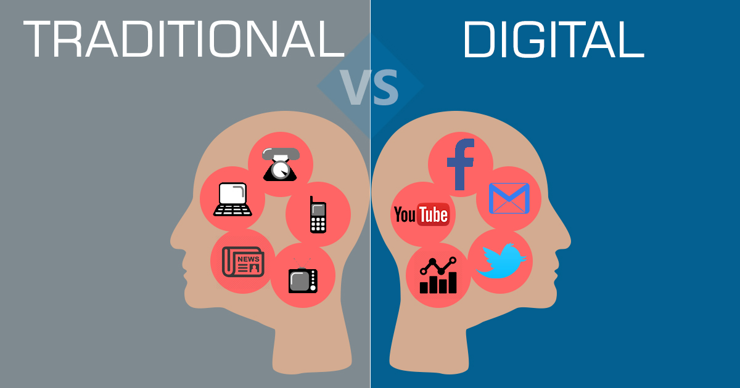



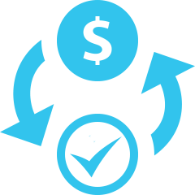
Solution ROI
Why should Cognizant invest in this solution?
Tremendous market potential
V.Low Investment - High Return
No existing SFE tools covers the extent of business problems we intent to target
Cognizant entry to AI/ML based SFE solution space
Why should your client invest in this solution?
+
Initial Development Cost (Resource Direct Cost, Infra [Seat, System], Contingency, Testing with other technologies, etc.) | $30,000 - $40,000
Maitenence Cost | $12,000
Deployment Cost | $20,000
1st Time Deployment Revenue | $250,000 – $300,000
Return (after first deployment) | 300%
Sharing Best Practices
5% -10%
Sales Performance Lift
10% -20%
$50M -$100M
Drop in low potential calls
Savings in Big Markets
60% -70%
$250K
Reduction in future runs
Savings Per Brand a Year

Slide 18





Challenges / Risk
Stiff Competition
Rep’s Perception
Cost Factor
For budget Constrained markets (APAC,LATAM)
Too many insights
Balancing Standardization and Customization

Slide 19
Competitor Analysis
EINSTEIN AI
(Salesforce)
NAVIGATOR
(ZS Associates)
HUBSPOT
Sales IQ
(Axtria)
MENDEL
(COGNIZANT)
Rep Coaching
Guide Marketers
Sales Reporting KPI
CRM Based Tool
Segmentation
Territory Design
Pricing Strategy
Salesforce Integration
Lead Management
Sales Analytics
Marketing Automation
Multichannel Call Planning
Roster management
Field Reporting
End to End SFE Solution
Integration of traditional and digital data
Flexible implementation for both data rich and data poor geographies
Modular approach: Can be deployed on top on any existing platform
Tactical insights to Reps for quick decision making and Strategic insights to leadership for long term investment

Slide 20








Prospective Clients showcase
Collaborating with Client Partner to pitch the Mendel POC solution to various stakeholders at Merck
PCYC has shown interest in AI-based application for “next best call”.
Planning to showcase our “Next Best Action(NBA) and Next Best Plan(NBP) modules of our Mendel solution
AbbVie is building HCP 360 data repository.
AbbVie has also rolled out a RFP on Decision Support system where one of the use case is ‘Field Suggestions’
We are planning to showcase Mendel’s Customer 360 and NBA/NBP modules to customer
Segmentation and Targeting activities in EU managed through CoE team in UK.
We are collaborating with UK Engagement Lead to identify relevant EU opportunities
Cognizant team has run S&T activities for Sanofi across 8 different markets across globe using offline Excel Tools
Client has shown interest in an online solution
We intend to demonstrate our MENDEL’s AI/ML solution to the group

Slide 21
